Slide 1

Algorithms and Data Structures 1 CS 0445
Fall 2023
Runtime Analysis of Recursive Algorithms
Proof By Induction
Sherif Khattab
ksm73@pitt.edu
(Slides are adapted from Dr. Ramirez’s and Dr. Farnan’s CS 0445 slides)

Slide 2
Announcements
Upcoming Deadlines:
Homework 7: Tuesday 10/31 @ 11:59 pm
Programming Assignment 3: Friday 11/3 @ 11:59 pm
Midterm Questions Redo: Tues. 11/7 @ 11:59 pm
up to 7 points back

Slide 3
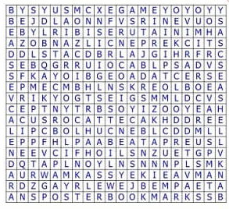
Word Search Problem
Find a given word in a grid of letters
may change direction in the middle of the word
Up to 8 possible directions:
Cannot use the same square twice
Example: PIPE
Example: TOY
Example: PEN
https://www.word-game-world.com/print-out-word-search.html

Slide 4
Recursive Solution for Word Search
Define the problem at hand
Input: a word to search for and a letter grid
Output: positions of the adjacent word letters in the letter grid
Base Case:
Finding the last letter in a legal square
Try all eight directions from previous letter
If letter already used, skip that direction
If last letter found, print solution and report solution found; otherwise, return not found
Recursive Case:
Friend can find sub-word (from a given letter) starting from a given square in grid
Find “1st letter” in a legal square
Then ask friend to solve subproblem from “2nd letter” and “1st letter”’s square
Friend reports no solution -> find another legal square for “1st letter” if possible and repeat
Friend reports a solution, return solution found
Revisit the inputs and output
Inputs: starting letter number and starting square’s row and column
Output: a Boolean indicating if solution found

Slide 5
Checking legal squares
For the 1st letter, all squares in the grid are legal
For subsequent letters,
Squares adjacent to previous square are legal
previously used squares are not legal

Slide 6
Word Search: Find all solutions
Base Case:
Finding the last letter in all legal square
Try all eight directions from previous letter
If letter already used, skip that direction
If last letter found, print solution and continue
Recursive Case:
Friend can find sub-word (from a given letter) starting from a given square in grid
Find “1st letter” in all legal squares
Ask friend to solve subproblem from “2nd letter” and “1st letter”’s square
Find another legal square for “1st letter” if possible and repeat
Revisit the inputs and output
Inputs: starting letter number and starting square’s row and column
Output: No output needed

Slide 7
Backtracking Framework: find all solutions
void solve(current decision, partial solution) {
for each choice at the current decision {
if choice is valid {
apply choice to partial solution
if partial solution a valid solution
report partial solution as a final solution
if more decisions possible
solve(next decision, updated partial solution)
undo changes to partial solution
}
}
}

Slide 8
Backtracking Framework Applied to Word Search
void solve(row and column of current cell, word and letter no.) {
for each of the eight neighbors { //why 8?
if inside the grid and hasn’t been used and == word[letter no.] {
mark neighbor as used
if last letter
print solution
else
solve(row and column of neighbor, word and letter no. + 1)
unmark the neighbor
}
}
}

Slide 9
Backtracking Algorithm for Word Search
Need to call solve on each cell in the grid

Slide 10
Backtracking Framework: find one solution
boolean solve(current decision, partial solution) {
for each choice at the current decision {
if choice is valid {
apply choice to partial solution
if partial solution a valid solution
report partial solution as a final solution and return true
if more decisions possible
if solve(next decision, updated partial solution)
return true
undo changes to partial solution
}
}
}

Slide 11
Proof By Induction
Base Step
Inductive Step
Inductive Hypothesis
Examples:
Factorial
Sum of arithmetic series

Slide 12
Runtime analysis of Recursive Algorithms
Step 0: Assume running time of recursive algorithm is a function T(n) of input size n
Step 1: Build a Recurrence Relation for the running time function T(n)
Don’t forget the base case (e.g., T(1))
Step 2: Build an intuition to make a guess for a closed form for T(n)
By evaluating T(n) for small values of n
Step 3: Try to prove your guess for T(n) using proof by induction
If not successful, go back to Step 2

Slide 13
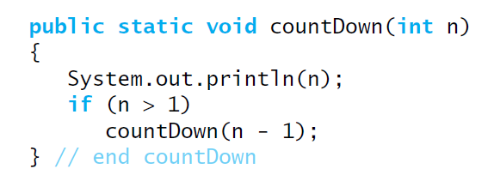
Example 1: countDown
Assume running time of countDown is a function of n: T(n)
T(n) = 1 + 1 + ??
What is the running time of countdown(n-1)?
Can we use the function T(n)?
Yes! The running time of countdown(n-1) is T(n-1)
T(n) = 2 + T(n-1)
= T(n-1) + O(1)
T(1) = O(1)

Slide 14
Running Time Analysis of Recursive Algorithms
T(1) = 1 … (1)
T(n) = T(n-1) + 1 for n>1 … (2)
The above equation is called a Recurrence Relation
T(2) = T(1) + 1 = 2
T(3) = T(2) + 1 = 2 + 1 = 3
T(4) = T(3) + 1 = 3 + 1 = 4
…
We have an intuition that the running time is linear
T(n) = n … (3)
Let’s prove (3) by induction
Base Case:
From (1): T(1) = 1
From (3): T(1) = 1
(3) applies to the base case

Slide 15
Running Time Analysis of Recursive Algorithms
Inductive Step:
Assume that (3) is true for all values < k and prove that it is true for k
Inductive hypothesis: T(n) = n for all n<k … (4)
We want to prove that T(k) = k
From (2), T(k) = T(k-1) + 1
From (4), T(k) = (k-1) + 1 = k
End of Proof that T(n) = n
So, running time of countdown is O(n)
T(1) = 1 … (1)
T(n) = T(n-1) + 1 for n>1 … (2)

